Slide 1
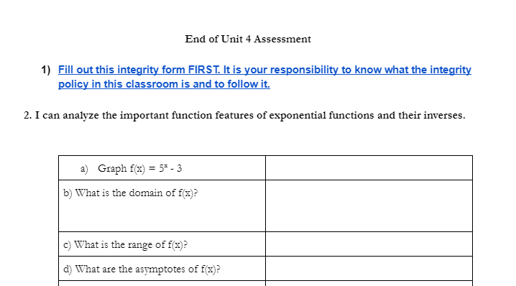
Assessment Design
Created google form outlining the integrity policy and collected student responses as evidence of having read and agreed to the policy.
Condensed NCDPI standards and rewrote in plain language.
This test item assesses student proficiency at NCDPI Precalculus standards F.4.1, F.4.3, and F.5.6.
Designed mathematical questions that assessed student proficiency toward NCDPI Precalculus standards.
Used tables to allow for student responses as pictures, screenshots, text, drawings or links.
Click on the image to view entire assessment

Slide 2
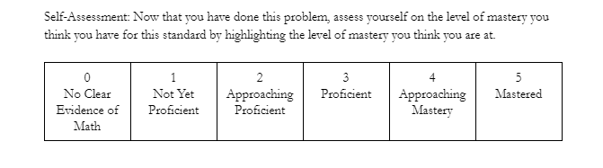
Assessment Design Cont.
Designed rubric for scoring student proficiency toward NCDPI Precalculus standards.
Created assessment in google documents and then uploaded to the canvas learning management system as a google assignment. Taught and expected students to respond to assessment questions in the corresponding table cell with both the answer to the prompt and discussion of their reasoning via text, screenshots, pictures, drawings or links. Graded assessments by highlighting the rubric scores for each condensed standard and using document comments to offer students feedback. Engaged with student responses to my feedback via document comments or interview appointments.

Slide 3
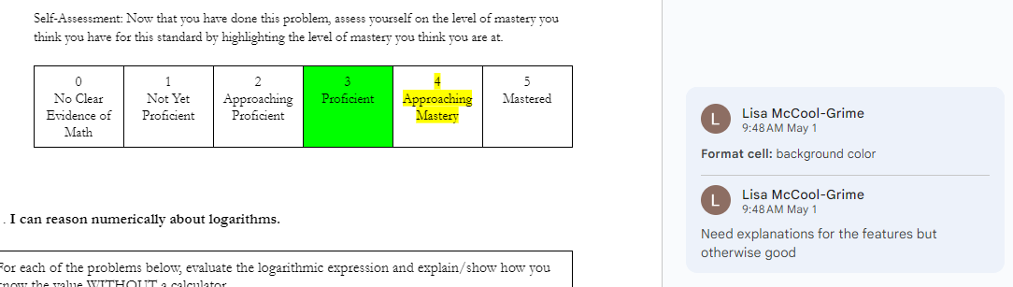
Sample Discourse
Student self-assessment after completing the problem prior to my assessment
My assessment toward the given standard after reading student work
My feedback to student about my rubric score via comments

Slide 4
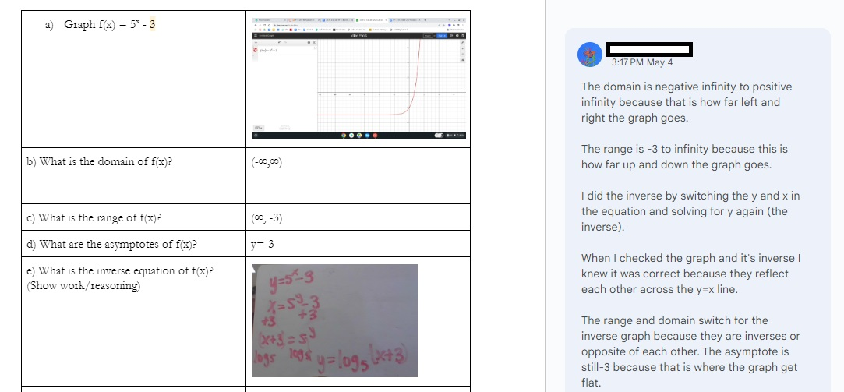
Student response in a comment to my feedback resulting in a reassessment of the rubric score to a 5
Sample Discourse Cont.
Taught students to use desmos calculator and upload screenshots as evidence of their graphical reasoning.
Original student work did not include explanations resulting in a rubric score of 3
Taught students to upload pictures of their algebraic reasoning.

Slide 5
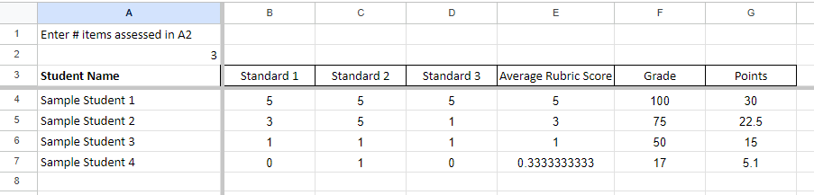
Synthesizing Assessment Data
Developed piecewise function to convert average rubric score to a grade on the 10-point scale according to these values:. Students who completed problems with fidelity could not score below a 50% where rubric scores of 1 - 5 mapped linearly to grades 50 - 100. Students who left blanks or broke the integrity policy could score below a 50.
Programmed spreadsheet to calculate points earned depending on user input for the number of standards assessed
User input for student rubric scores on assessment standards
Entered score into powerschool based on a point system that counted each standard assessed as 10 points, allowing assessments to vary the number of standards assessed at one time without weighting some standards less than others.
Click on the image to interact with a copy of this spreadsheet

